Slide 1

Get Scanning: Your Ultimate Guide to QR Code Generators!

Slide 2





Welcome to QR Codes
In this presentation, we'll explore the world of and how they can enhance your digital
experience. From to , we'll
cover everything you need to know to get started with these nifty little codes!

Slide 3



What is a QR Code?
, or Quick Response Codes, are two-dimensional barcodes that can store information. They can be scanned using smartphones to quickly access websites, contact information, or even make payments. Their versatility makes them a popular choice in today's tech-savvy world.

Slide 4



Using is a great way to share information quickly and effciently. They save time, reduce the need for physical materials, and can be easily integrated into marketing strategies. Plus, they can engage customers in a fun and interactive way!

Slide 5

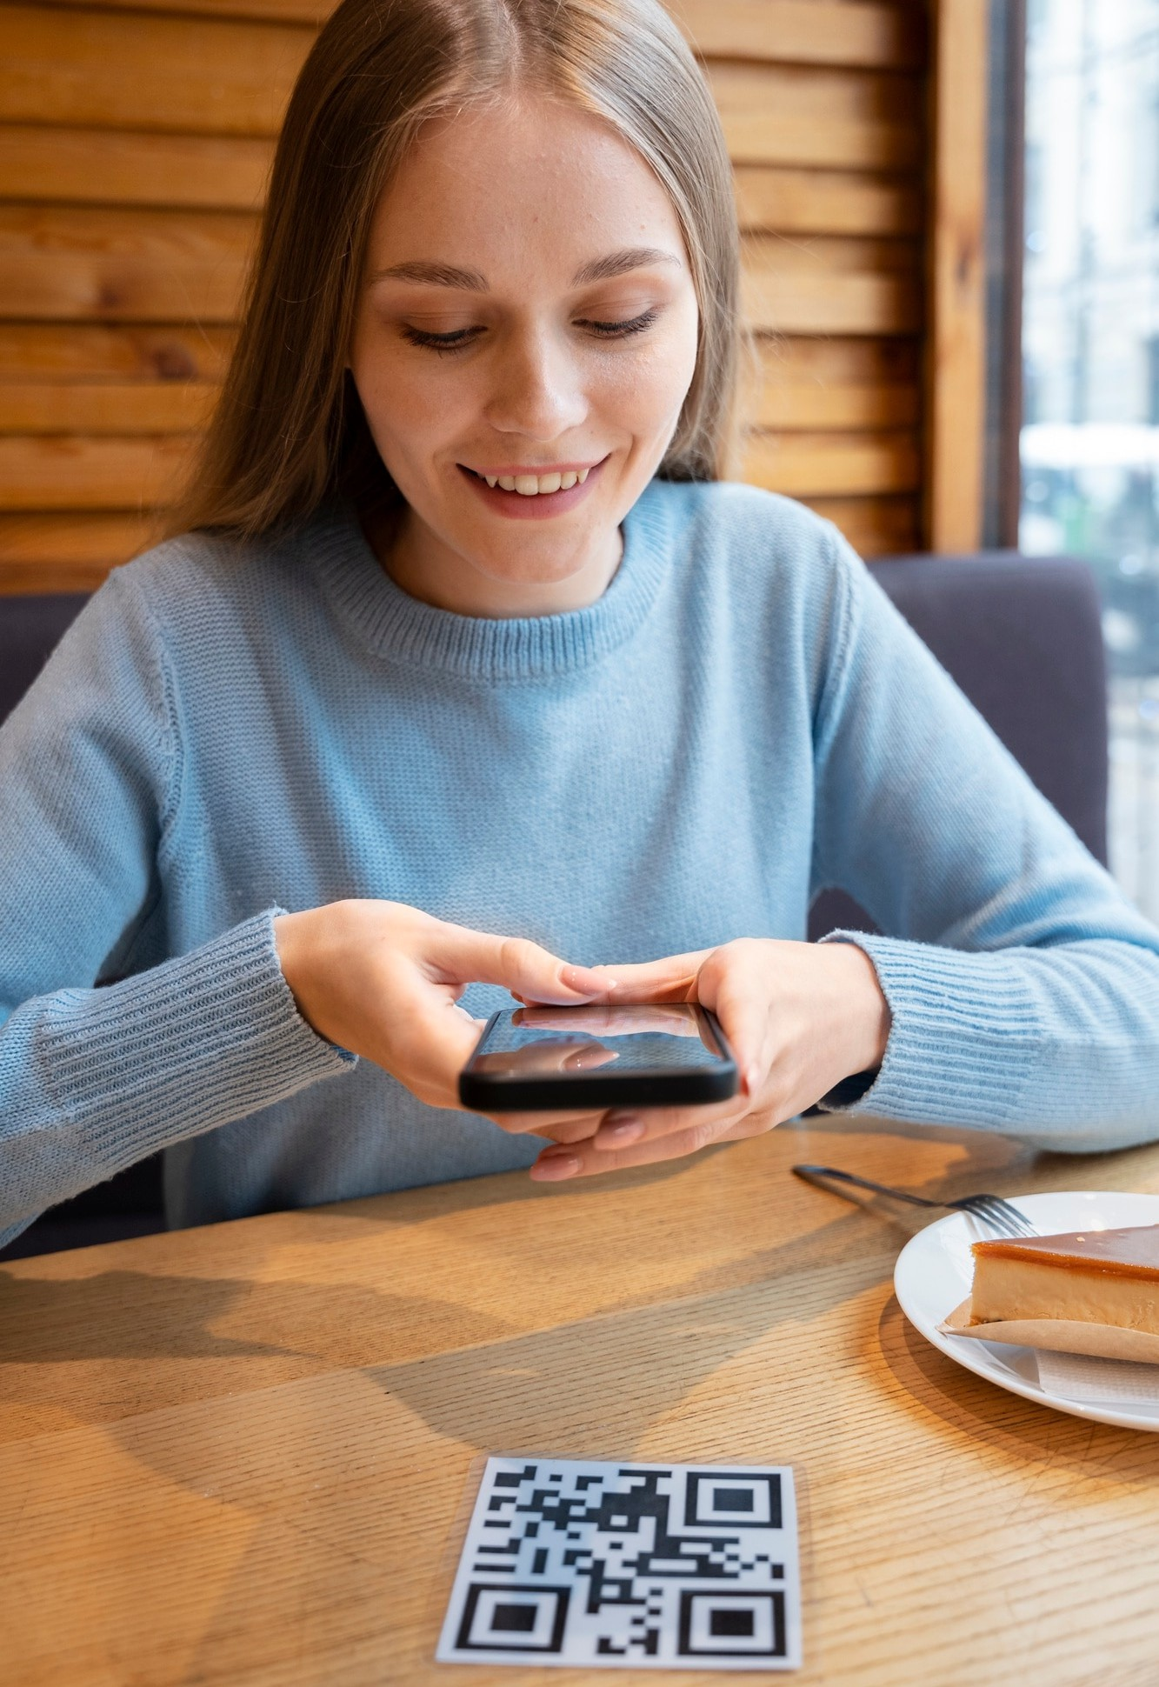

Choosing a QR Code Generator
When selecting a , consider factors like
, customization options, and whether it tracks scans. Some generators oﬀer free services, while others
provide premium features. Choose one that fits your needs and budget!

Slide 6

How to Create a QR Code
Creating a is simple! Just enter the information you want to encode, choose your design, and hit generate. Most generators will allow you to customize colors and add logos. It's a fun way to make your code unique!

Slide 7


Scanning QR Codes
Scanning a is just as easy! Open your smartphone's camera or a QR scanner app, point it at the code, and tap the notification that appears. You'll be instantly connected to the information encoded within the code!

Slide 8

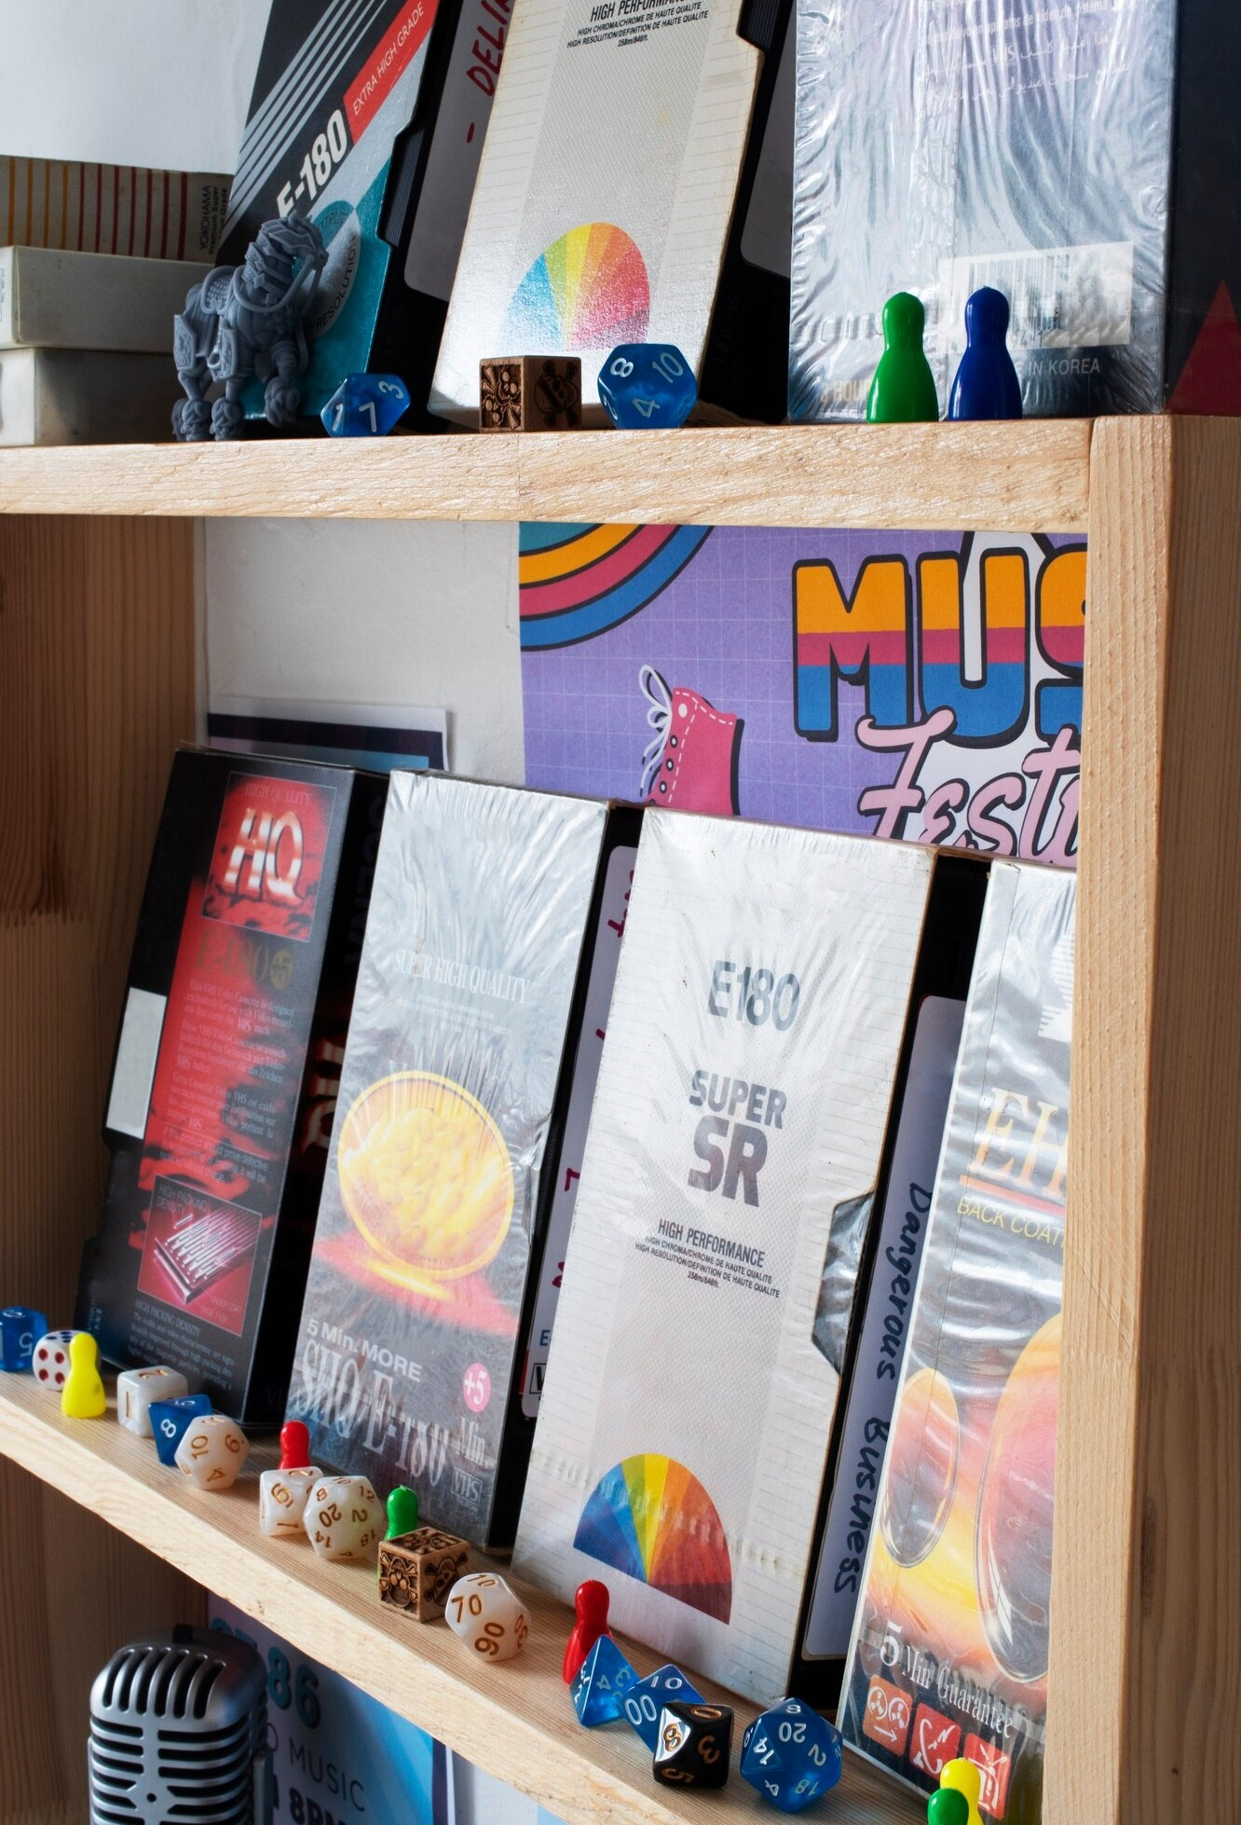


Best Practices
To get the most out of your , ensure they are placed in visible locations, test them before distribution, and provide context for users.
Consider using them in , on business cards, or at events for maximum engagement.

Slide 9



QR Codes are a powerful tool for sharing information eﬀortlessly. With the right and a bit of creativity, you can leverage them to enhance your marketing eﬀorts and connect with your audience in exciting ways. Get scanning!

Slide 10




The Project By:- Arju Alam Aditya Singh
Abhishek Kumar Jha

